Slide 1

XERO
Vaishnavi Dasari(QA Manager) Manoj Challapalli (QA Analyst) Chandana Seelam (QA Analyst) Saikar Reddypally(Business Analyst) Tejaswi Talluru(Business Analyst) Vinod Kumar Alluru(Software Tester) Srija Vanka(Software Tester) Praharsha Reddy Beemidi(Software Tester) Sree Vishnu Dommaraju(Software Tester) Mani Chandana Kilaru(Software Tester)

Slide 2
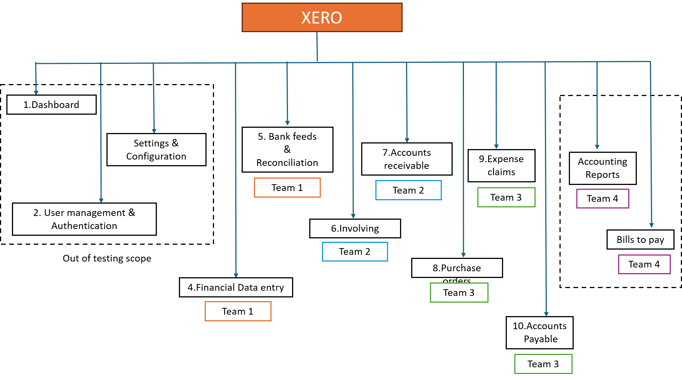
Functional Decomposition Diagram

Slide 3
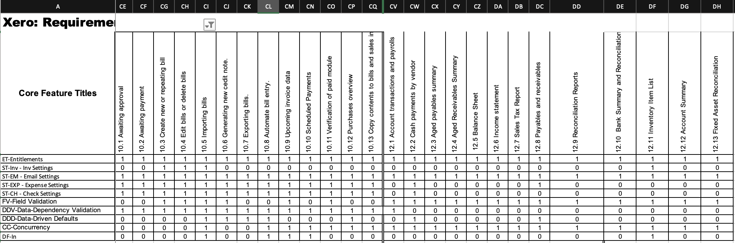
RCT

Slide 4
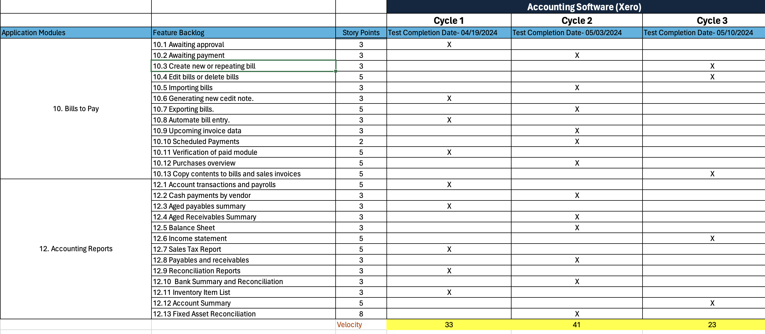
Testing RoadMap

Slide 5
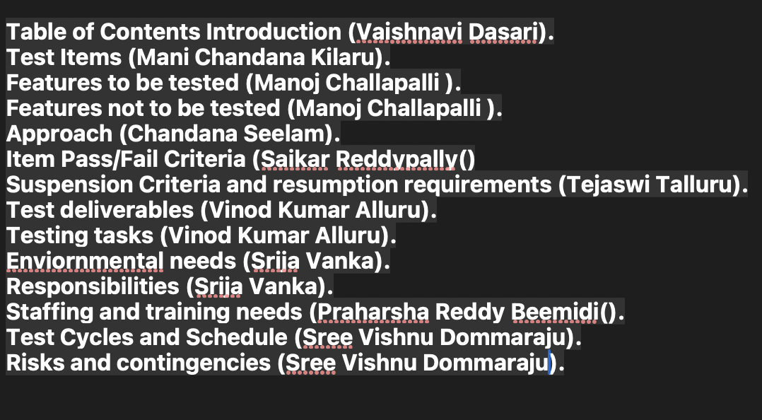
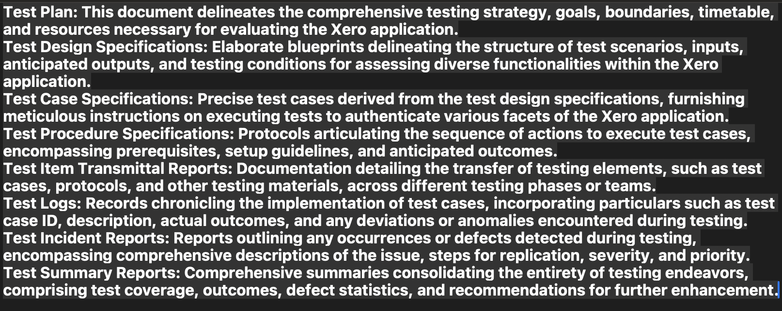
Test Plan

Slide 6
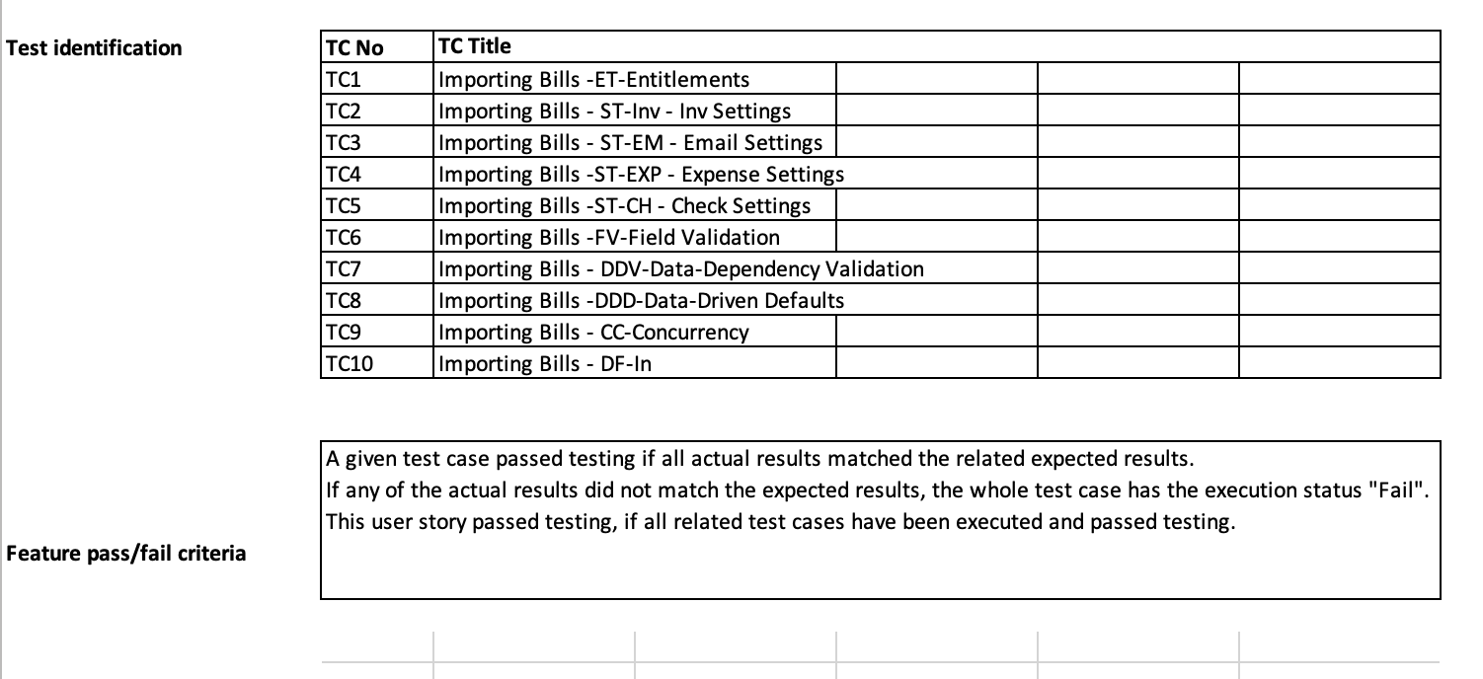
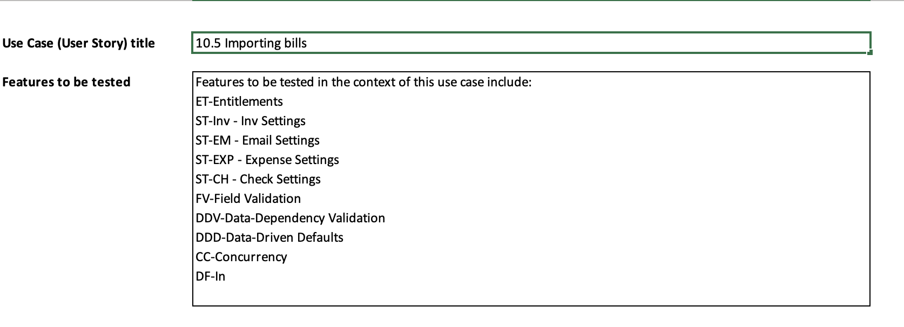
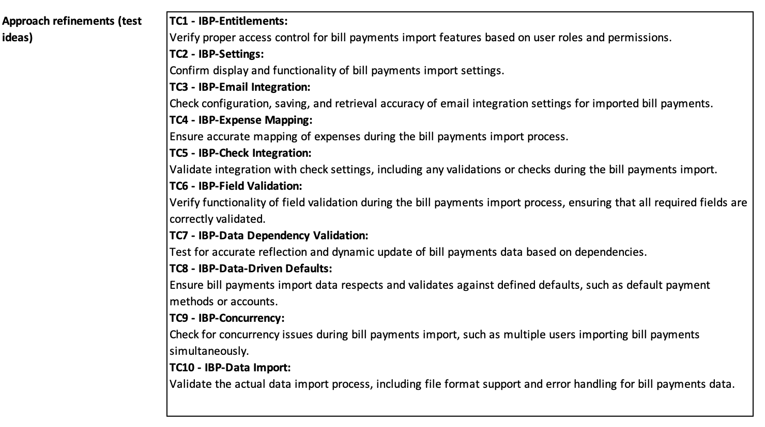
Test Design Specification

Slide 7
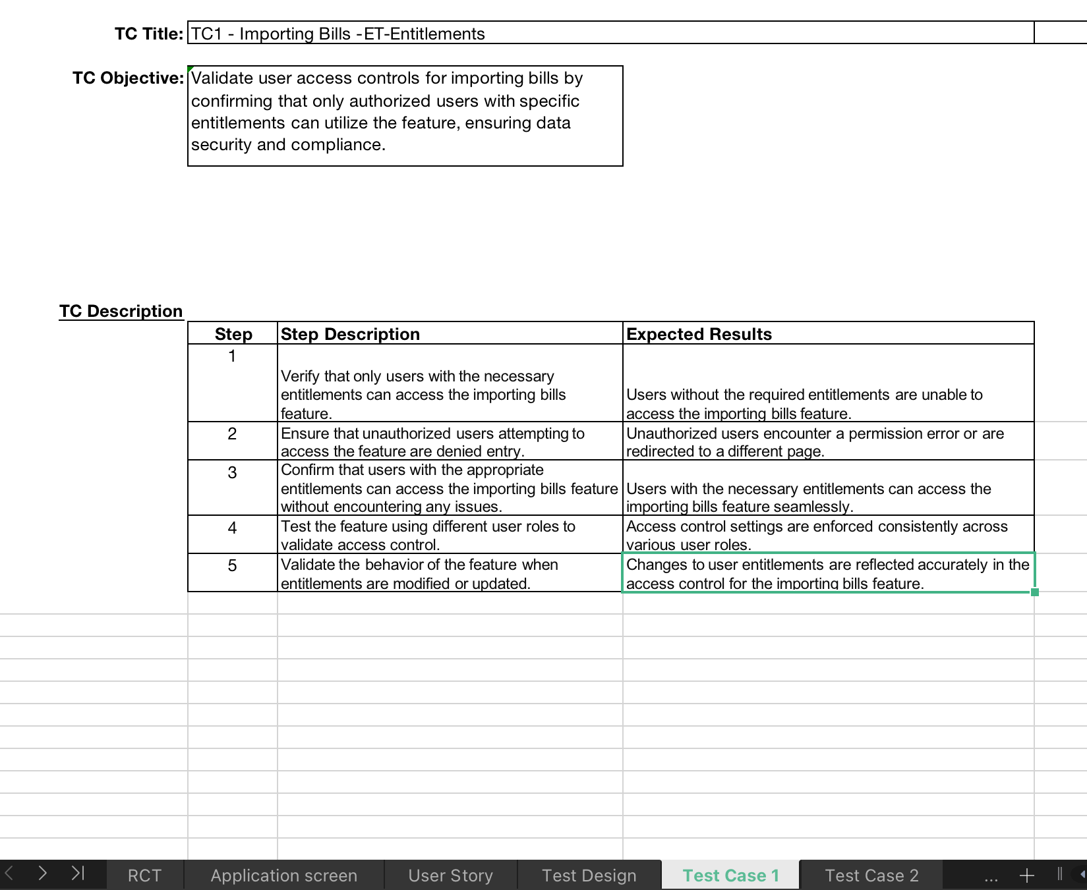
Test Case Specification

Slide 8
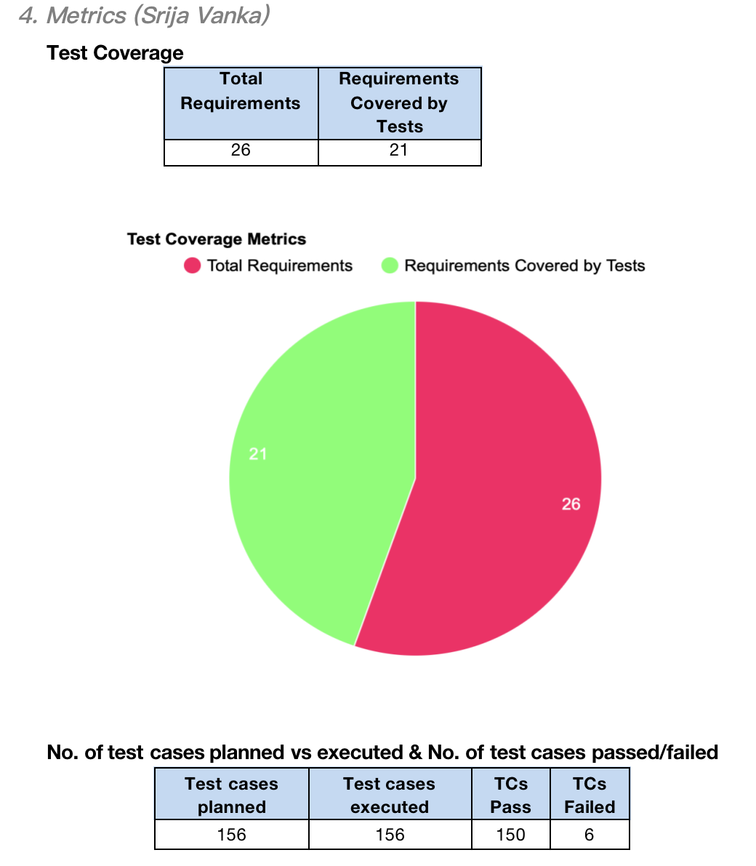
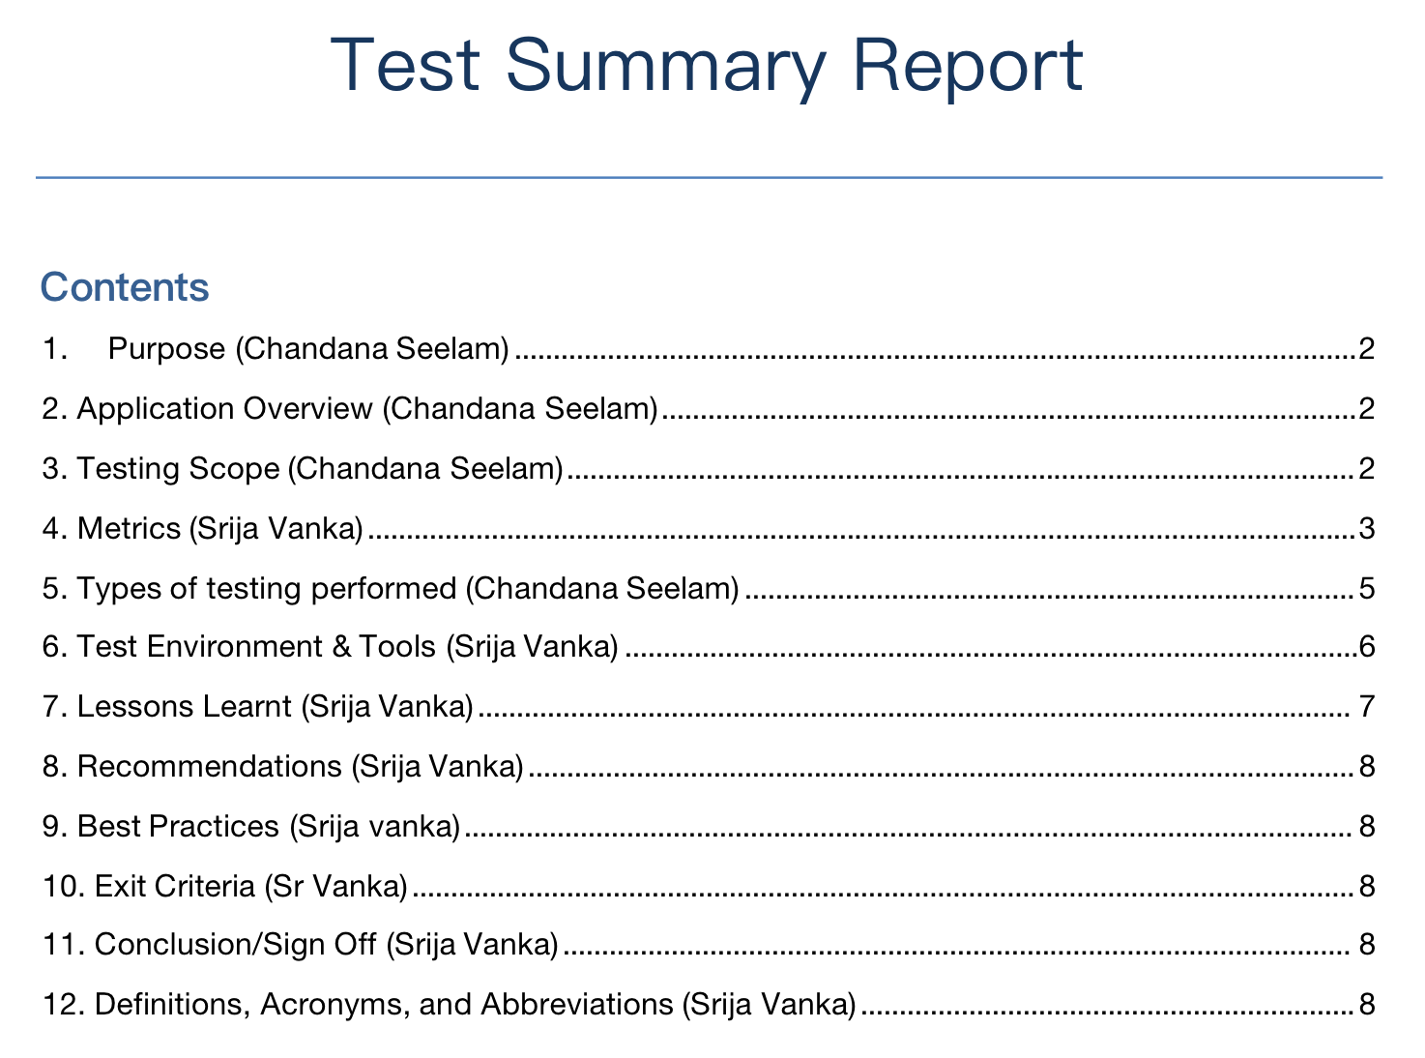
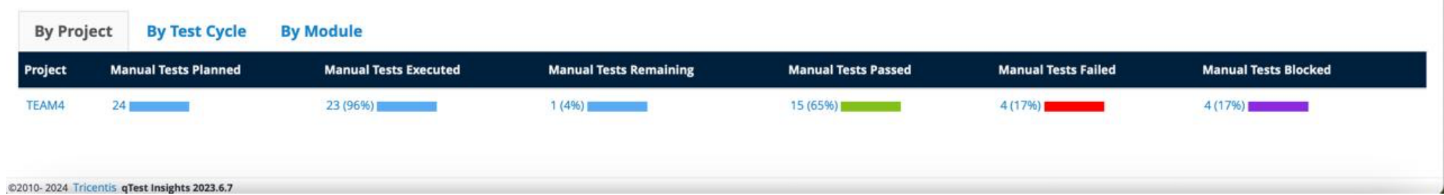
Test Summary Report

Slide 9
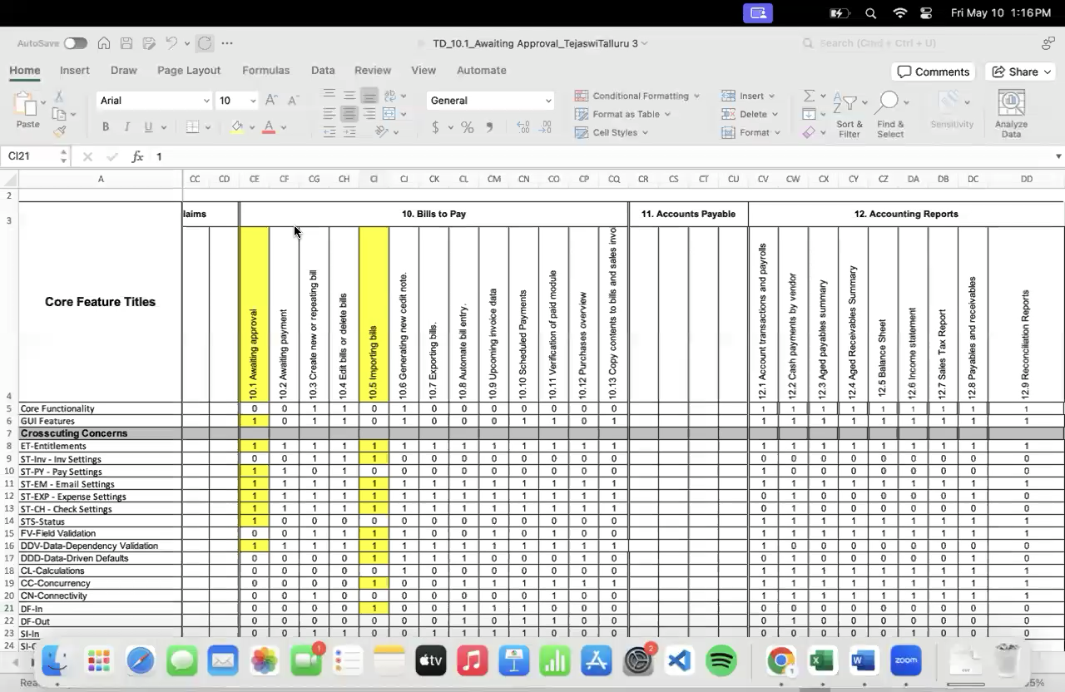
Application Recorded Demo

Slide 10
Appendix: GitHub Repository

Slide 11
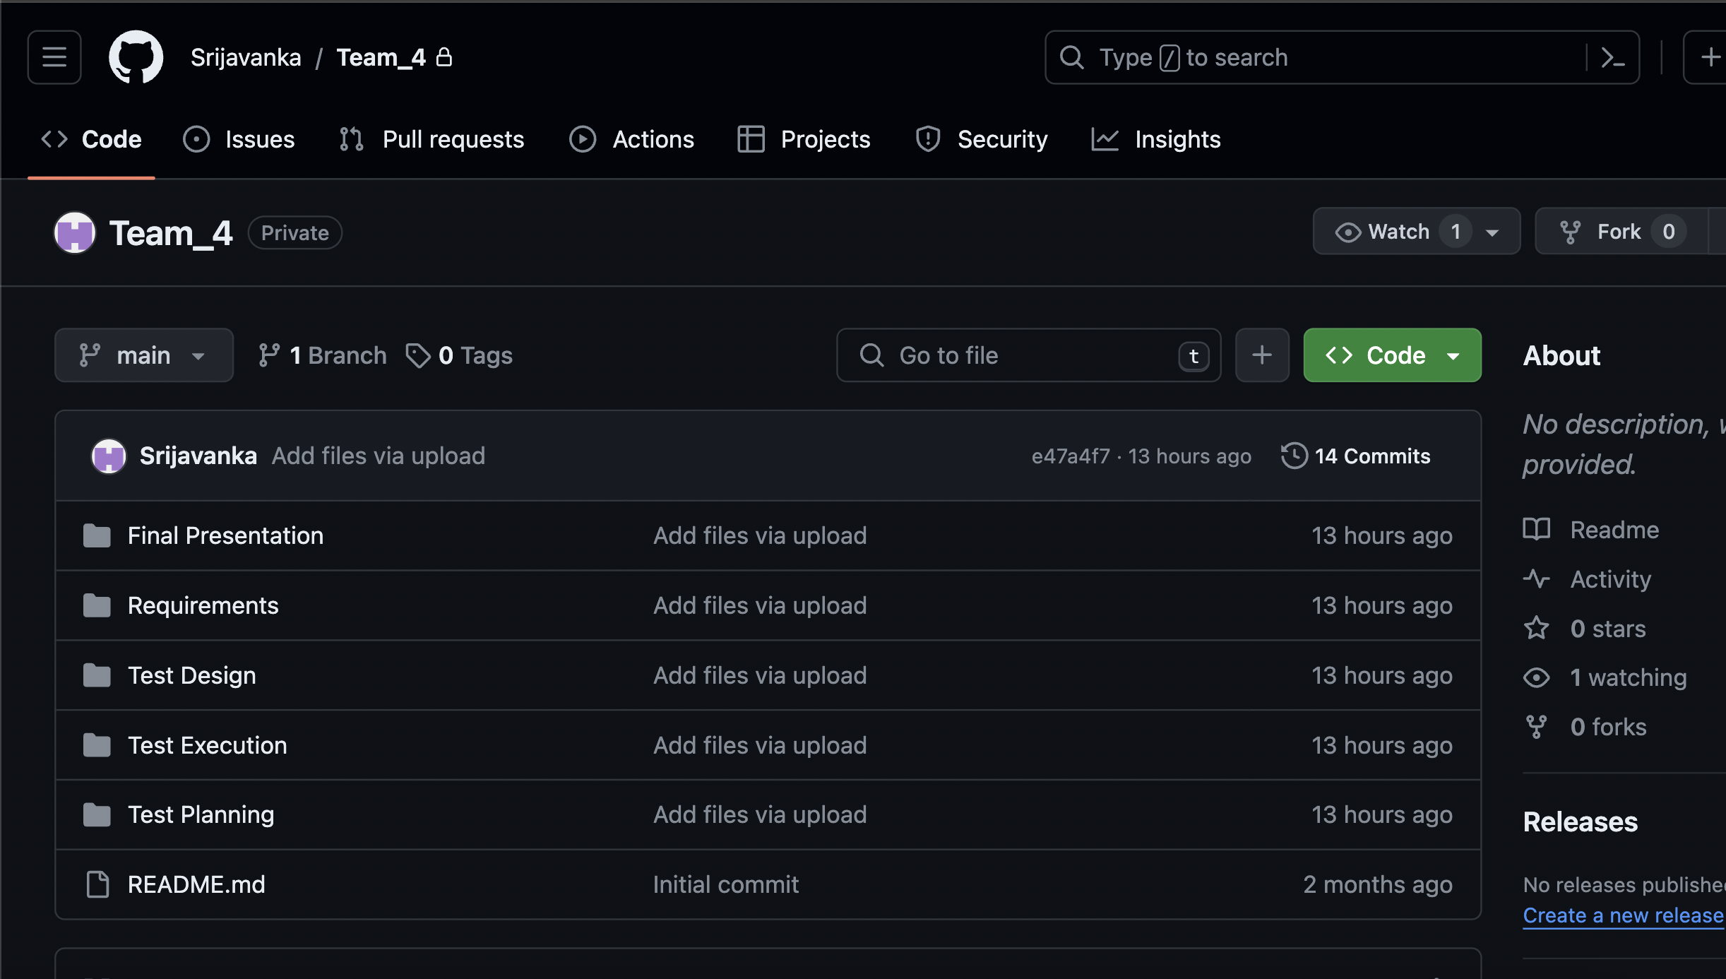
GitHub Repo Link
https://github.com/Srijavanka/Team_4/blob/main/Test%20Design

Slide 12
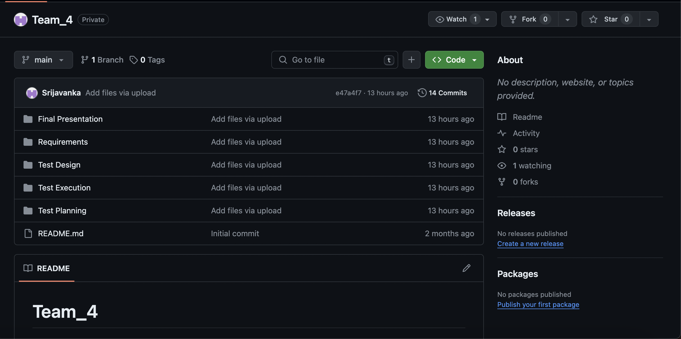
GitHub Repo Folder Structure

Slide 13
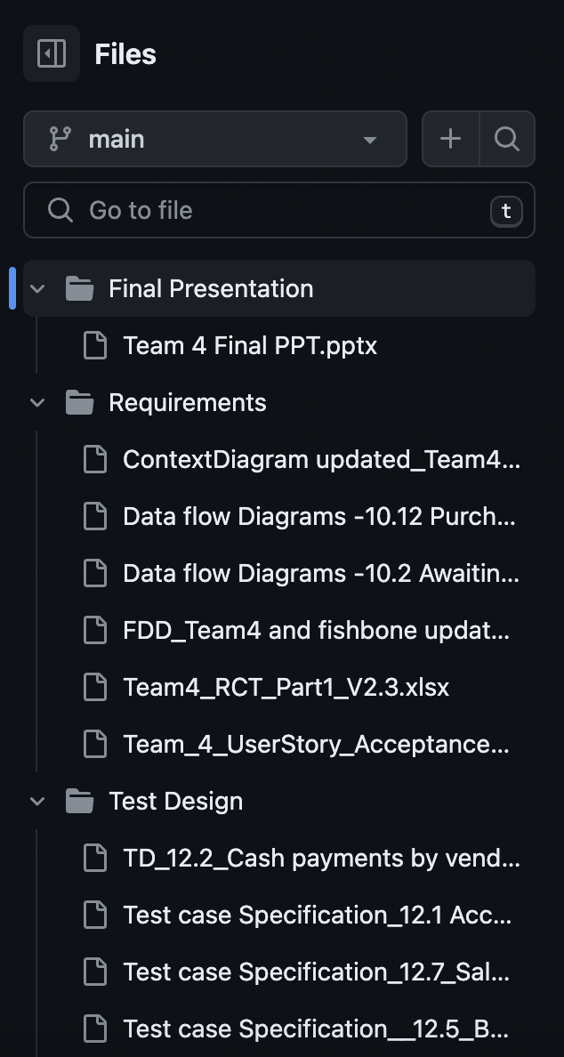
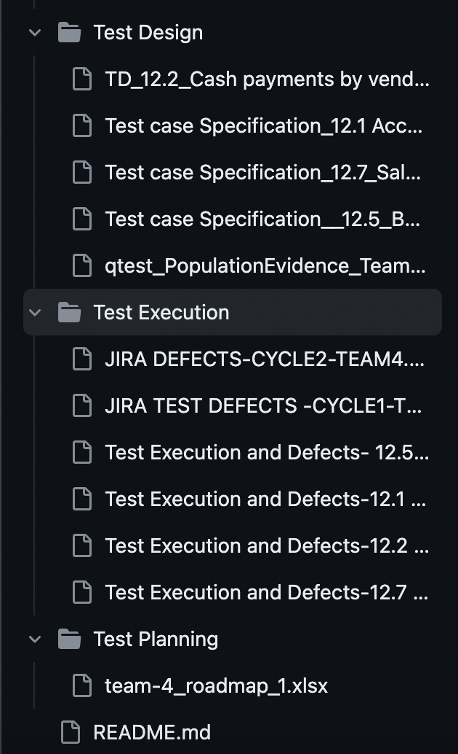
GitHub Repo Folder Structure

Slide 14
Thank You

